Slide 1




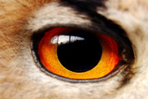
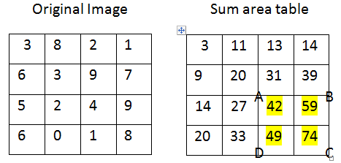
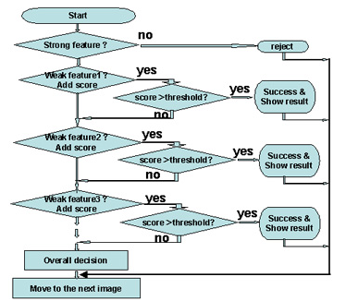
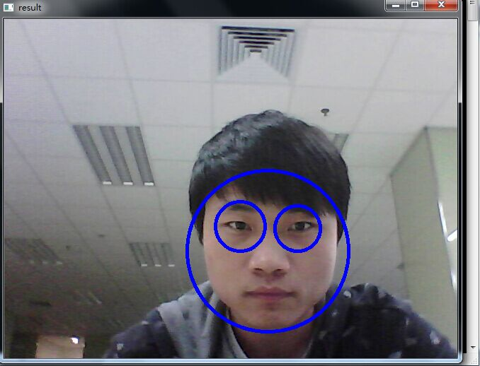
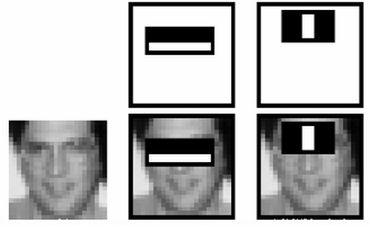
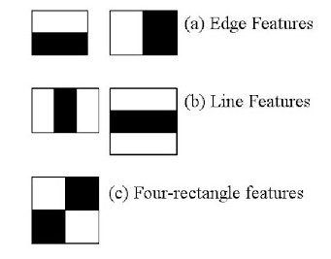
ADABOOST-BASED EYE DETECTION-
Jiashen Zhang, Luting Wang, Gary Overett *
Sun Yat-sen University–Carnegie Mellon University, SYSU-CMU Joint Institute of Engineering
*Email: overett@mail.sysu.edu.cn
Jiashen zhang Luting Wang
Introduction
Use Integral Image
Cascade strong classifiers
Human face image analysis, detection and recognition have become some of the most important research topics in
The Integral Image is used as a quick and effective way of calculating the sum of values in a given image. Figure 2 shows how it works.
In an image, most of the image region is non-face. So it is better to have a simple method to check if a window is a face region or not. If it is not, discard it in a single shot. It is achieved by Cascade of Classifiers. It is illustrated in the following figure.
the field of computer vision and pattern classification. Among these research topics, one fundamental but very important problem to be solved is automatic eye detection. One promising approach is to use Haar features and AdaBoost algorithm to get cascade classifiers. In this project, first we will see some basics of face detection using Haar Feature-based Cascade Classifiers, which is an effective object detection method proposed by Paul Viola and Michael Jones in 2001[1]. Then we will extend the same to eye detection.
Figure 2. Integral Image
As shown in the figure above, to find the sum of the highlighted parts, sum = C+A-B-D. So we have sum = 22.
There are several steps to achieve it:
Extract Haar-like features
Use Integral Image to speed up calculation
Train strong classifier use Adaboost Algorithm
Cascade strong classifiers together
Sliding window to detect
The Adaboost Algorithm
Figure 4. Recognition
Consider the image below. Top row shows two good features. The first feature selected seems to focus on the property that the region of the eyes is often darker than the region of the nose and cheeks. The second feature selected relies on the property that the eyes are darker than the bridge of the nose. But the same windows applying on cheeks or any other place is irrelevant. So we should select the best features, and it is achieved by Adaboost Algorithm.
Results
Methods
Extract Haar-like features
Initially, we have a lot of positive images and negative images. Then we need to extract features from it. Haar features are shown in Figure 1. Each feature is a single value obtained by subtracting sum of pixels under white rectangle from sum of pixels under black rectangle. Given a 24x24 window, it will result in over 160000 features. So integral images is introduced to simplify and speed up calculation.
Figure 5. result
Conclusions
In this project, we reviewed one eye detection method based on Haar-like features. We implemented it in OpenCV, and the result is shown in Figure 5.
Figure 3. Good Haar features of eyes
For each feature, find the best threshold classifies faces to positive and negative, select the feature with minimum error rate.
For each iteration, pick the optimal weak classifier with the lowest error rate, and update sample’s weight
Final classifier is a weighted sum of these weak classifiers
References
[1] Viola P, Jones M. Rapid object detection using a boosted cascade of simple features
[2] Viola P, Jones M J. Robust real-time face
detection
[3] Face Detection using Haar Cascades, OpenCV-
Python Tutorials
[4]T. Liao et al. "Structure-Aligned Guidance Estimation in Surface Parameterization Using Eigenfunction-based Cross Field." Graphical Models
Figure 1. Haar features
Address: No. 132, East Waihuan Road, Guangzhou Higher Education Mega Center, Guangzhou, 510006, P.R. China
Tel: 86-20-39943579; 86-20-39943581
E-mail: sysucmu@mail.sysu.edu.cn

